Slide 1
Warner Media Data Day 2020- Use Cases

Slide 2
Warner Media Team Presentations Part 1:
Revenue Analytics
Warner Media International
Warner Bros Digital Labs
Xandr - AIR
Accelerated Analytics
Turner Sports

Slide 3

Revenue Analytics Digital Ads Analytics Platform (DAAP)
Building a Digital Ads Analytics Platform for the sales organization
Executive Sponsor Terrence Fischer
VP of Revenue Analytics
Terrence.Fischer@turner.com
New York

Slide 4



Revenue Analytics – Digital Ads Analytics Platform (DAAP)
Eric Brodie Director of Product Management
Eric.brodie@turner.com
New York
Gerry Dorsainvil Director of Analytics
Gerry.dorsainvil@turner.com
New York
Eric Vazquez Principal Architect
Eric.Vazquez@turner.com
New York

Slide 5
Revenue Analytics Data Use Cases
Use Case | Data Sources | Impact | Challenges | Owner
Campaign Management | GAM/FreeWheel (Ad Serving) Operative.One (Order Management) IAS/MOAT (Viewability) Ad-juster (3rd Party tracking) Nielsen/Salesforce (Demo/Audience reporting) | Properly trafficked & delivered campaigns Advertiser relations & renewals Core business | Need real time data Lots of disparate data sources Vendors data delivery issues | Gerry Dorsainvil
Yield Management | GAM/FreeWheel/Sprinklr (Ad Serving) Operative.One (Order Management) | Optimized selling via pricing and inventory Opportunity analyses | Prescriptive analytics | Gerry Dorsainvil
Programmatic Optimization | GAM/FreeWheel/STAQ (Ad Serving) Xandr/SpotX (Programmatic Exchange) | Improved inventory utilization Additional advertiser relationships Audience selling | Need real time data Massive data processing & joins | Gerry Dorsainvil
Ad Tech Monitoring | GAM/FreeWheel (Ad Serving); YoSpace (Serve-side Ad Insertion); | More immediate issue resolution Less avoidable lost revenue Better ad experience | Need real time data Massive data processing Addressable alerts | Gerry Dorsainvil
Business Planning | GAM/FreeWheel/STAQ (Ad Serving) Operative.One (Order Management) Salesforce (Sales pipeline) | Growth opportunities Sales strategy Budget allocation | Long term forecasting Cross-business data aggregation User adoption | Gerry Dorsainvil
Sales Insights | GAM/FreeWheel (Ad Serving) Salesforce DMP (Audiences) Operative.One (Order Management) | Resources for sales Better pitches & upsells Inventory packaging | Exploring complex dictionary data High data cardinality Creating insights intuitively for users | Gerry Dorsainvil
Inventory Forecasting | FreeWheel based proprietary models (Ad Serving) | Less underselling/overselling Advertiser relations & renewals | Generating features Maintaining accuracy & optimizing | Eric Brodie

Slide 6
International Data & Analytics

Slide 7
Meet the Team
Alexey, Sally, Dafyd, Scott
Shyam, Eric, Adarsh, Tammim, Brent,
Jamaal, Jason, Prabu
Yuki
Divya
Esteban
Mauro
Rocio
Ana

Slide 8
International Use cases
Use Case | Data Sources | Impact | Challenges
Financial Reporting | Hyperion, Peoplesoft, OperativeOne, external agency data | Single, International view of incomes, pacing reporting. Finance & non-finance teams have the ability to see financial data | No single format, or agreed cadence with external partners. Multiple P&L systems across the business.
Digital Ad Sales Reporting | GAM(DFP), Freewheel, Adobe, Op1, Moat/IAS, Staq, Sharethrough | Understand how our digital revenue is generated, so it can be optimised for our advertisers. | Volumes of data (100’s of bn’s of rows) hundreds of dimensions and measures
Competitive reporting | Third party vendors (Auditsa, admetricks, megatime, ibope) | Ability for Sales execs to understand our position relative to the market | Different formats, measures and granularity across the vendors
Linear Reporting | Nielsen, GFK, Kantar (across 30+ countries) via techedge | Ability to automate reporting and compare linear ratings data across the regions and globally | Volumes of API calls, constant changing of channels etc
Content reporting | Scheduling systems, traffic system, masterdata system, Rights management system | Ability for legal, content teams, digital and sales teams to understand our catalogue, the rights we hold and sell | Lack of consistent IDs
Social & Digital | Youtube, Instagram, Facebook, App store, Adobe | Understand how we are engaging with our fans | Volumes of data (100’s of bn’s of rows) hundreds of dimensions and measures

Slide 9
Performance Deep dive – The challenges
The data is updated hourly
25 months of data needed for some views
Daily grain needs for other reports
High data cardinality
Data sources and scale
Data source | Data scale | Columns
Adobe – CNN.COM | 160 billion rows | 576
Adobe – international sites | 22 billion rows | 576
Google Ad Manager (GAM) | 231 billion rows | 60
FreeWheel | 380 billion rows | 126

Slide 10
Performance Deep dive – The Solution
Timedate vs Date (Ugly SQL)
LOOKER SQL Generator ((((ad_cls_cnn_web_activity.DATE_TIME ) >= ((TO_DATE(DATEADD('month', -1, DATE_TRUNC('month', CURRENT_DATE()))))) AND (ad_cls_cnn_web_activity.DATE_TIME ) < ((TO_DATE(DATEADD('month', 1, DATEADD('month', -1, DATE_TRUNC('month', CURRENT_DATE())))))))))
Slim Tables
Aggregate awareness
PDTs & NDTs

Slide 11
Performance Deep Dive – Results
Average performance improvements for query times
Metric | Before | After | improvement
GAM dashboards load time – 24 months of data | c20-30 mins (with some load failures) | c3-7 seconds (consistent loading time on all dashboards) | 99.7%
FreeWheel dashboards – 24 months of data | c20-30 mins (with some load failures) | c3-7 seconds (consistent loading time on all dashboards) | 99.7%
Adobe explore – 24 months of data | c30 mins (with some load failures) | c30 seconds | 98.3%
Filter columns – multiple explores | 20 seconds – to never (depending on source view size) | c1-2 seconds (depending on sources view size) | 92.5%

Slide 12
WBDL Data & Analytics
Leading analytics scoping and analysis for the team at Warner Bros. Digital Labs.

Slide 13


WBDL Data & Analytics
Nikhil Bhat Product Manager, Data & Analytics
nikhil.bhat@warnerbros.com
Maryland (Remote)
Brian Waligorski
Data Engineer
brian.waligorski@warnerbros.com
Philadelphia

Slide 14
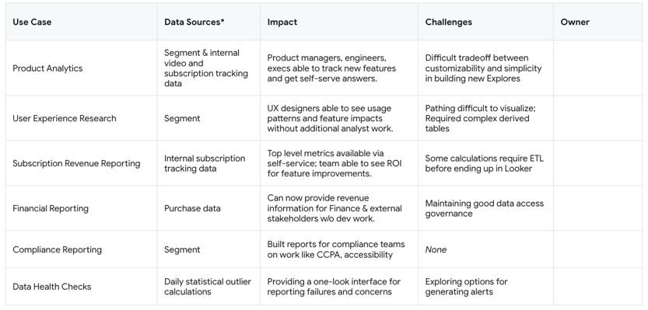
WBDL Data & Analytics Data Use Cases
* All WBDL data surfaced in Looker via AWS Redshift

Slide 15
Advertising Intelligence and Reporting (AIR)
Executive Sponsors Misty Cornelio
VP Sales Operations
misty.cornelio@xandr.com
Gina Condos
Director – Engineering
gina.condos@xandr.com
Provides Data, Measurement, Reporting and Analytics Capability
Centralized Reporting Platform on the Cloud for Xandr Media

Slide 16
Advertising Intelligence and Reporting (AIR)
Alex Bourland
Associate Director - Product
alexander.bourland@xandr.com
NY
Rex Tan Associate Director - Engineering
xavier.tan@xandr.com
NY
Walter Arp System Architect
walter.arp@xandr.com
CA
Neha Shidore Software Engineer
neha.shidore@xandr.com
NJ

Slide 17
AIR Team - Data Use Cases
Use Case | Data Sources | Impact | Challenges | Owner
Campaign Delivery Metrics Did we deliver on impressions ? Did we deliver on reach ? What is the distribution of reach on platforms/network? | Campaigns, Audience Segments, Impressions, Internal Metrics, 3rd Party Metrics | Non-technical users now have the ability to self serve and can make decisions in near real-time. | Disparate data sources didn’t initially map well. It was difficult to understand what sources were more important. | Operations Team
Viewing metrics How do you define ‘viewed’ per platform ? Exposed for 1 sec ? Full graphic for digital ? | Viewing and Impression Logs | Enable more analytics (eg effectiveness of campaign or ad, viewing behavior) | Analytics use case are viewed multi-dimensionally are best served with cube-like structures | Reporting and Analytics Team

Slide 18

Data Products & Platforms Accelerated Analytics (former iCUE)
Democratizing Data and Accelerating net-new insights
Executive Sponsor Robert Jones
VP, Platforms and Strategy Ops
Robert.Jones@WarnerMedia.com
Somewhere in Connecticut or England 🤷🏻‍♂️

Slide 19




Accelerated Analytics
Sravanthi Aluvala Director, Tools & Analytics
Sravanthi.Aluvala@WarnerMedia.com
Atlanta
Bobby Hall Program Management
Bobby.Hall@WarnerMedia.com
Atlanta… but he secretly wants to be in NYC… 🤫
Andrés Monsalve Sr. Manager, Buss. Insights
Andres.Monsalve@WarnerMedia.com
NYC
Sridhar Julapally Viz Engineer
Stephen.Shepher@WarnerMedia.com
Atlanta
Stephen Shepherd Data Engineer
Stephen.Shepher@WarnerMedia.com
Atlanta
He’s not officially in our team but he’s in our team. He’s with Cloud Architecture

Slide 20
Accelerated Analytics Data Use Cases
Use Case |  | Data Sources | Impact | Challenges | Owner
Fan Profiling | In Prod - Epsilon & Live Ramp based Automated Audience Profiling Workflow​ WIP - Neustar based audience profiling for linear audiences and improved digital ​ audience profiling​ | Linear and digital fan lists – Krux, Adobe, Offline audiences, Inscape 3rd party data providers – Live ramp, Epsilon Neustar | Inform discovery process for new programming Help editorial with content development Support ad sales pitches | Low Match rates for digital fans Cross platform fan profiling Lack of consolidated fan lists for offline audiences | Sravanthi Aluvala Looker Dev: Sridhar Julapally
Fan Engagement | In Prod – Linear MIT/AMRLD Analytics​ In Prod – Conviva, PRISM, Inscape Analytics​ WIP – Cross-Platform Analytics using Neustar ID Spine​ | Nielsen AMRLD/MIT Conviva Inscape Neustar | Accelerate Legacy Reporting Automation Self-service reporting Data Democratization | Workflows & ETL processes Data aggregation and calculations | Andrés Monsalve & Sravanthi Aluvala Looker Dev: Sridhar Julapally Nick Kazmer Jay White
Behavioral Insights | In Prod - Inscape Linear Audience Journey​ In Prod - Digital Churn Analysis​ In Prod - Linear Lead-in Analysis​ | Inscape Nielsen Conviva | Determine best placement across the portfolio for promos – i.e. which networks’ audiences best align with each other/specific shows for cross promotion | Lack of Inscape national representativeness | Sravanthi Aluvala Looker Dev: Sridhar Julapally Nick Kazmer Jay White
Competitive Insights | In Prod - Marketplace​ In Prod - Benchmarking Analysis (Linear)​ | AdIntel SMI MIT | Determine the under/overshare of Ad spend across the industry | Multiple disparate datasets to be joined and aggregated | Andrés Monsalve Looker Dev: Sridhar Julapally Jay White
NOT IN LOOKER Look-a-like-Modeling | In Prod - Epsilon based LAL modeling for known audiences (email)​ WIP – Neustar based LAL modeling for IP based linear audiences ​ (ADSM Primal LAL POC)​ | Linear and digital fan lists & engagement data – Krux, Adobe, Convivia, Offline audiences, Inscape 3rd party data providers – Live ramp, Epsilon Neustar | Efficiently target prospective fans that are most likely to watch Market sizing and acquisition of new fans | Finding reliable predictors with high accuracy | Sravanthi Aluvala
NOT IN LOOKER Fan Segmentation | In Prod - Ad-Hoc Segmentation of CNN newsletter audiences, CNN ​site visitor​ Planned – User driven ML based fan segmentation | Linear and digital fan lists & engagement data – Krux, Adobe, Convivia, Offline audiences, Inscape 3rd party data providers – Live ramp, Epsilon Neustar | Identify high value fans and uncover opportunities to grow that segment Track product penetration by demographic/lifestyle cohorts | Normalized fan and content identifiers across sources and platforms | Sravanthi Aluvala

Slide 21



Turner Sports – Data Strategy & Insights
Renee Ducre Sr. Director of Data Strategy
Renee.Ducre@Turner.com
Atlanta
Ashar Naseer Director of Sports Data Technology
Ashar.Naseer@Turner.com
Atlanta
Krishna Chanduri BI Developer
Krishna.Chanduri@Turner.com
Atlanta

Slide 22



Turner Sports – Product Insights
Shawn Spring Director, Product Insights
Shawn.Spring@Turner.com
Atlanta
Mordecai Brown
Sr. Manager, Product Insights
Mordecai.Brown@Turner.com
Atlanta
Marcus Stone Data Architect
Marcus.Stone@Turner.com
Atlanta

Slide 23
Data Strategy & Insights Use Cases – NBA TV & ELEAGUE
Use Case | Data Sources | Impact | Challenges | Owner(s)
NBA TV Actuals Report | Upon request | Tracks performance of Linear programming Tracks competitor performance by network Tracks key metrics : top telecast, audience flow, etc. | Need real time data updates Disparate data sources Needed to support Return to Play for NBA in the bubble | M. Dewolfe C. Walton V. Pritts K. Chanduri
NBATV Net Comp Qtr Hr Breakouts | Upon request | Network Comparison dashboard with quarter hour breakouts (save and access via web browser for full metrics) | Need a dashboard to see competitive network broken out by the quarter hour | M. Dewolfe C. Walton V. Pritts K. Chanduri
NBATV Net Comp Grid | Upon request | Network Comparison dashboard | Need a dashboard to track performance across competitive networks | M. Dewolfe C. Walton V. Pritts K. Chanduri
ELEAGUE Dashboard | Upon request | Created ELEAGUE dashboard that summarizes overall business performance Audience profile Top performing programs Lead-In Analysis, etc. | Need real-time data updates | D. Middlebrooks E. Clapper K. Chanduri M. Brown

Slide 24
Product Insights
Enabling data-driven decision making for Product Teams.

Slide 25
Data Strategy & Insights Use Cases - March Madness
Use Case | Data Sources | Impact | Challenges | Owner
Cross-Platform Reporting | Upon request | Contextual understanding of platform audiences Centralized location for product teams to understand platform and device trends In location audience reporting for Ops team Core business reporting | Need real time updates Need a suite of self-service reports that frees up the insights team to focus on mining data in tournament. | M. Stone
Daily Registration Reporting | Upon request | Keep a pulse on internal and external registration campaigns Enable early indicators on audience health Troubleshoot retention and registration drop off points | Need real time updates | M. Stone
NCAA Digital Dashboard | Upon request | Created to enable content and business operations teams to: Understand in Championship pacing, without Looker we were restricted to post Championship lookbacks. Contextualize performance for each sport relative to historical trends and reference sports for that season and division. | Need real time updates Massive data processing Need to dynamically adjust for point of season trends across sports with different season pacing | M. Stone
Source of Traffic Reporting | Upon request | Enable holistic review of internal and external campaigns in a singular location Contextualize campaign contributions to total audience Diagnose and investigate under-performing campaigns | Need real time data updates Massive data processing Disparate data sources | M. Brown

Slide 26
Warner Media Team Presentations Part 2:
Enterprise Data Solutions- BI
WB Games
Ellation
Cloud Platforms
CNN
Xandr - Data View

Slide 27


Enterprise Data Solutions - BI
Business Intelligence Team supporting the WarnerMedia Enterprise in accessing, analyzing and building data solutions with visualization tools.
Leadership Team:
Matt Teshera EVP
Matthew.Teshera@warnermedia.com
NYC
Scott Moran Sr. Director
Scott.Moran@hbo.com
NYC

Slide 28








EDS - Business Intelligence
Archana Vedulla Sr. Business Analyst
Archana.Vedulla@hbo.com
NYC
Amjad Khan Technical Lead
Amjad.Khan@hbo.com
NYC
Derek Ku
Technical Lead
Derek.Ku@hbo.com
NYC
Pamela Zirpoli Technical Manager
Pamela.Zirpoli@hbo.com
NYC
Phani Kiran Balla
Consultant
Phanikiran.Balla@hbo.com
NYC
Sugumar. Ramasamy
Consultant
Sugumar.Ramasamy@hbo.com
India
Mallika Akkala
Consultant
Mallika..Akkala@hbo.com
NYC
Phanindra Ravipati
Consultant
Phanindra.Ravipati@hbo.com
NYC

Slide 29
EDS Business Intelligence- Data Use Cases
Use Case | Data Sources | Impact | Challenges | Owner
Media Supply Chain | Product, Contract and Rights Scheduling Creative Services Descriptive & Technical Metadata Content Metadata Distribution | Migrating Legacy Reporting Users to utilize self serve data exploration. | Pixel Perfect Formatting Requirements Large Report Outputs (Rows & Columns Legacy Reporting Requirements for Operation Workflow | Media Supply Chain
HBOMAX DATA Insights | Streaming Subscription Marketing Content Consumer Fraud | Establishing a Data Organization in which users may self serve and make decisions in near real-time. | Massive Data Processing Siloed Developer Teams | HBOMAX Business
Consumer Insights & Analytics | Cross Platform Analytics Ratings Marketing Content | Business Analysts share insights across internal customers. | Use of Multiple Visualization Tools Disparate DataSets | Data Science & Research
Corporate Systems | Legal Residuals Finance | Migrating Legacy Reporting Users to utilize self serve data exploration. | Use of Multiple Visualization Tools Pixel Perfect Formatting & Complex Calculation Requirements Data Sensitivity Large Report Outputs (Rows & Columns Legacy Reporting Requirements for Operation Workflow | Legal & Finance

Slide 30

WB Games Data Platform and Analytics: “WBA”
Collect, curate, analyze, and support the
use of data across the Games business
Matt Howell Executive Director, Analytics
mhowell@wbgames.com
Boston, MA

Slide 31

Central Data Insights
Shawn Connor Director, Data Insights
sconnor@wbgames.com
Needham, MA
& Team
Sample Use Cases | Data Sources | Impact | Challenges
Slate Reporting – High-level daily status summaries of all in-market titles | Marketing Measurement Platform (MMP), game telemetry | Single, authoritative, up-to-date view of performance creates cohesion across business verticals. | Many complex data processes, some with different owners, have to be coordinated every day.
Core Data Products – Common, reusable components to power multiple insights | Too many to count | Big data becomes medium-sized and performant, while standardizing business definitions for complex concepts. | Each data source has its own foibles, and they don’t always tell the same story.
Sales Modeling – Combine diverse monetization signals into one story | Digital storefronts, ad monetization, user profiles, ... | We understand, to a very high level of detail, the contribution of each user to revenue. Very rare in games! | We are rarely the merchant of record, and console monetization signals are often probabilistic.
Democratization Tools & Processes – Establish the data sharing and governance patterns for all data users | N/A | Empowering diverse data teams to perform their own independent development while holding to common standards. | Tool chains, skill sets, and access are not homogenous across the organization.
LTV Prediction – Assess the most likely long-term trajectory of a new user | Game telemetry, purchases | React more quickly to changing markets, as well as new and changing game performance. | In free-to-play titles, LTVs have highly-skewed distributions that are mathematically hard to predict.

Slide 32

Game Analytics Support
Andrei Muratov Manager, Insights Products
andrei.muratov@wbgames.com
Montreal, QC
& Team
Sample Use Cases | Data Sources | Impact | Challenges
Game Development Support – Make better games in less time | Game telemetry Playtest video, observations & surveys | Quantify qualitative observations and improve prioritization and design decisions. Reduce development risk. | Telemetry integration competes with game feature development. Balancing of transferrable standards and custom context. Value of insights often depends on speed. Game worlds not easily represented in common viz tools.
Market Intelligence – Compare and contrast competitor title performance to our own | Publically-available market signals | Validation/observation of competing publisher’s releases and strategies. Early detection of new market opportunities. Set better targets. | Clear and complete data is not available, inferring KPIs from a variety of sources, verifying against own titles.
Player Behavior Analysis – Inform live operational decisions | Game telemetry | Understanding player participation in game features, and patterns of behavior that lead to positive and negative outcomes, and recommending product updates. | Precise tracking and inference at scale.
Game Personalization – Adapt the game to individual players’ motivations | Game telemetry | Modifying individual players’ game experience to encourage positive and discourage negative outcomes. | Finding most effective interventions/personalization elements and applying them in a timely manner.

Slide 33

Publishing Analytics Support
Ken Yu Publishing Analytics
x.kenneth.yu@wbgconsultant.com
San Francisco, CA
& Team
Sample Use Cases | Data Sources | Impact | Challenges
Return on Ad Spend – Measure the direct and indirect topline benefits of advertising | Marketing Measurement Platform (MMP), game telemetry | Increase investment in performant channels faster and with higher confidence | The connection between advertising and revenue continues to become more indirect
Operating Income Modeling – Advertising is one of the biggest influencers of OI | MMP, game telemetry, monetization | Right-size advertising investment based on holistic impact to a franchise rather than pure performance marketing | All of the challenges of RoAS (above), plus markets and game performance change over time
Ad Fatigue – Identify when ad units will have been in market too long, in time to change them. | MMP | Reduce the cost of new assets, and increase the performance of existing ones. | Advertising platform data is messy; organizing and annotating body of content is hard
Media Mix Modeling – Quantify the relationships between non-deterministic advertising channels and eventual revenue | MMP, Publically available market signals | Advertise confidently in a broader range of channels and under changing (less direct attribution) conditions | Finding signals from, and unpicking the changing effects of dozens or hundreds of distinct channels
Conversion Value Optimization – Maximize the predictive power of our SKAdNetwork conversion values | MMP, game telemetry | Operate in Apple’s new attribution-less framework | Standards are still evolving, no established best practices yet

Slide 34

Ellation Data & BI
Providing insights and analysis to teams at Crunchyroll.
Gareth White Director of Analytics and Research
gareth.white@crunchyroll.com
San Francisco, CA

Slide 35





Crunchyroll
Jae Choi Senior Data Analyst
jae.choi@crunchyroll.com
San Francisco, CA
Wen Zhang Data Engineer
wen.zhang@crunchyroll.com
San Francisco, CA
Shilpi Chakrabarti Product Manager
shilpi.chakrabarti@crunchyroll.com
San Francisco, CA
Steffie Ko Senior Analyst, Business Intelligence
steffie.ko@crunchyroll.com
San Francisco, CA
Chris Shea Senior Analyst, Content Analytics
chris.shea@crunchyroll.com
San Francisco, CA

Slide 36
Crunchyroll Data Use Cases
Use Case | Data Sources | Impact | Challenges | Owner
Content Analytics | Internal Viewership Data | Non-technical users can track content performance on their own and also have access to pre-built reports for in-depth analysis. | If users aren’t onboarded properly, they have a hard time navigating themselves and get discouraged. | BI / Content team
Retention Analytics | Internal Subscription Data | Product Managers, Finance, and Execs have insight into paid and free trial subscriptions to understand user behavior. | Third-Party subscription sources can be hard to work with. | BI team
Feed Analytics | Internal Viewership, Media and User data | Product Managers can better understand why certain shows are popular than others, monitor the algorithm and model performance over time, etc. | A/B testing models quickly and efficiently | Data Science team
Data Quality Automation | Internal Subscription, Viewership and Operational data | Automated forecasting on key metrics and anomaly detection to help improve data quality. | Preprocessing needed before ingestion in order to use ML forecasting. Alerts can be hard to work with. | Data team

Slide 37

Cloud Platforms Data Platforms
Architecting the Cloud Platforms and solutions that power WarnerMedia
Don Browning VP of Cloud Architecture
don.browning@warnermedia.com
Atlanta

Slide 38





Data Platforms
Joe Krebs Senior Technical Manager
joe.krebs@warnermedia.com
Atlanta
Scott Coggin Principal Architect, Looker
scott.coggin@warnermedia.com
Atlanta
Virginia Giacomini Principal Architect
virginia.giacomini@warnermedia.com
Atlanta
Verlin Henderson Principal Architect
verlin.henderson@warnermedia.com
Atlanta
Stephen Shepherd Data Architect
stephen.shepherd@warnermedia.com
Atlanta

Slide 39
Cloud Platforms is the home of the Looker Team.
What is the Data Platform Team's Mission?
Cloud Data Architecture and Infrastructure Management
Support for WarnerMedia's Enterprise Data Storage, Engineering, and Analytics Platforms
How does Looker fit in to this mission?
The Data Platforms team supports the Cloud Architecture, Looker Administration, and Support Desk.
This is done by allocating a dedicated resource, Scott Coggin, to the Looker Platform. Additional bandwidth for support is provided by Cloud Engineering.

Slide 40
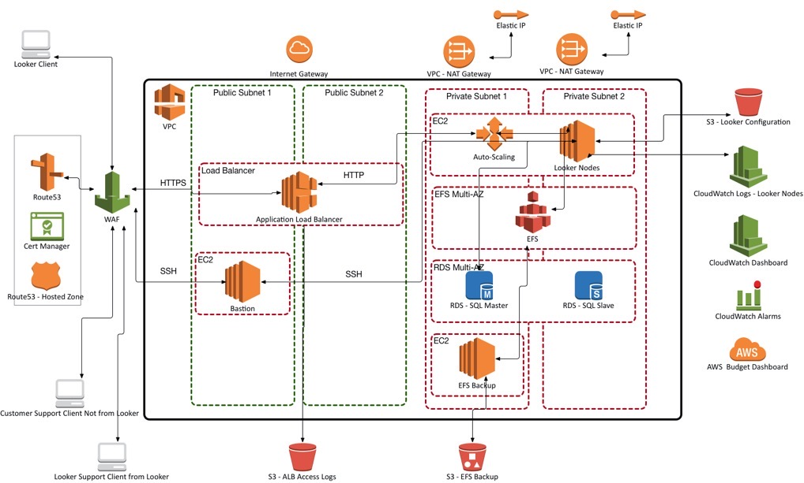
Cloud Architecture
Responsible for supervision and administration of Looker's cloud computing system.

Slide 41
Looker Architecture & Support
Responsible for Looker's Platform Administration
Authentication Services
Authorization: Permission Set + Model Set
Creating New Projects and Maintaining Existing Projects
License Administration, Version Upgrades
ServiceNow Form (https://warnermedia.service-now.com/)
Home > Make a Request > Cloud Services > New Looker Access Request
1000+ Support Requests Serviced in 18 months

Slide 42

CNN Revenue Insights
Empowering CNN Digital stakeholders to make informed business decisions that drive our business forward through the collection, measurement and analysis of revenue data.
Barrett Nichols Vice President, CNN Digital Business Operations
barrett.nichols@turner.com
Atlanta, GA

Slide 43





CNN Revenue Insights Team
Eric Espinoza
Sr. Director, CNN Digital Revenue Insights
eric.espinoza@turner.com
Atlanta, GA
John Romanski Data Engineer, CNN Digital Revenue Insights
john.romanski@turner.com
Philadelphia, PA
Mark Wiesyk Sr. Manager, CNN Digital Revenue Insights
mark.wiesyk@turner.com
Atlanta, GA
Bre Koppenhaver
Sr. Analyst, CNN Digital
Revenue Insights
Bre.Koppenhaver@turner.com
Atlanta, GA
Mark WIllard
Analyst, CNN Digital
Revenue Insights
Mark.Willard@turner.com
Atlanta, GA

Slide 44
Data Use Cases
Use Case | Data Sources | Impact | Challenges | Owner
Analyze WarnerMedia Direct and Programmatic Sales revenue data. | Google Ad Manager, Freewheel, Operative |  |  | WarnerMedia Sales, Revenue Analytics
Analyze audience and user engagement relative to revenue data. | Adobe Analytics, Databricks |  |  | Research, Audience Development
Analyze off-platform revenue data | Facebook, Google, YouTube, Twitter, etc. |  |  | Major Platforms
Analyze business development and performance marketing partner revenue data | Outbrain, Lending Tree, Smartasset, Dianomi, etc. |  |  | Performance Marketing
Analyze commerce revenue | Trackonomics, Stack Commerce, Affiliate Partners |  |  | Commerce
Analyze audio revenue | Omny, Operative, TuneIn, iHeart, Google Audio |  |  | WarnerMedia Audio, CNN Audio, Sales
Analyze CNN International revenue | Google Ad Manager, Freewheel, Operative |  |  | EMEA BI

Slide 45
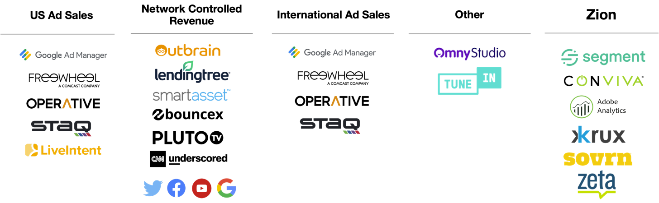
Today we have a fragmented revenue data landscape, making it difficult to analyze product decisions based on a holistic revenue picture.

Slide 47
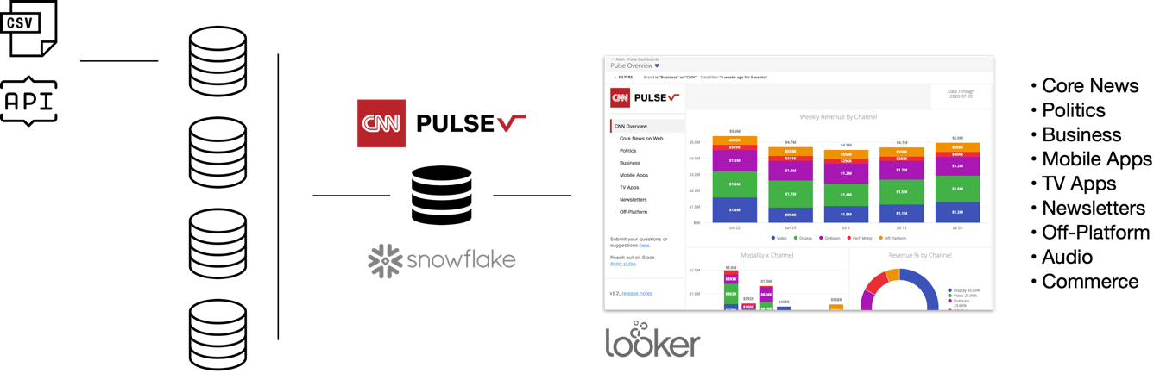
CNN Pulse combines all disparate revenue data into a single table and leverages the combined data set to build customer facing revenue BI dashboards.

Slide 48

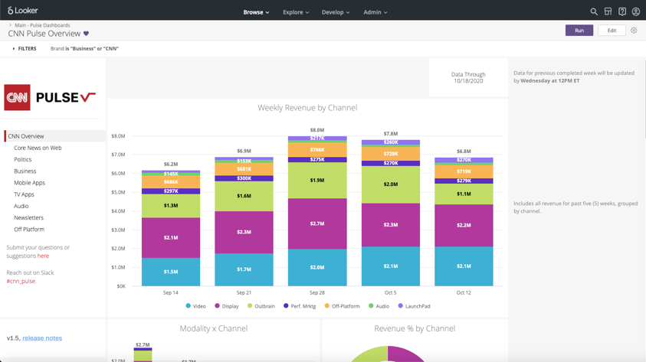
Leverages Looker to provide a consistent interface and a single destination for all revenue dashboards

Slide 49
Looker SDK and Looker API
We use the Looker SDK for Python to source data from existing Looker dashboards provided by other WM groups.
Airflow automates fetching of data, saving it to our own S3 buckets, importing it into Snowflake.
Revenue data is aggregated at a daily level. We are building aggregate weekly, monthly, quarterly revenue tables ourselves and pointing Looker at those to improve performance.
This approach vastly increases performance by pre-calculating the results included in our most popular dashboards.

Slide 50
Gazer
https://github.com/looker-open-source/gzr
Gazer is an open source Looker tool to import and export LookML dashboards via the command line
We use this from the command line to backup, copy, duplicate, and validate our LookML dashboards.
This approach has enabled us to very quickly modify Looks across many dashboards, and to keep a version history of dashboards.

Slide 51
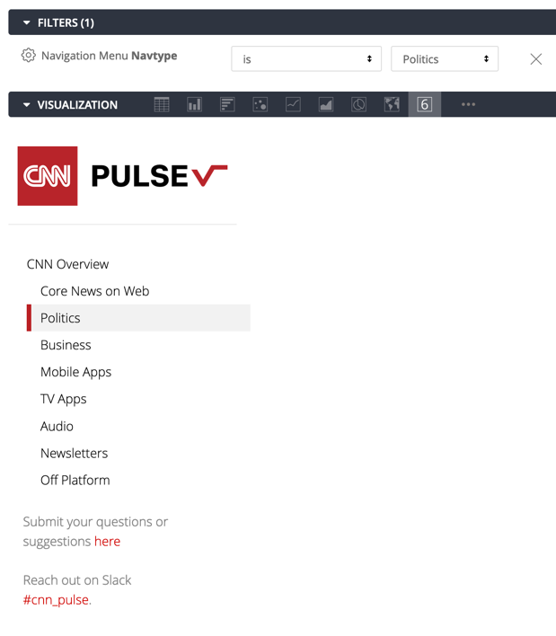
Custom HTML Navigation
We use the ‘Single Value’ visualization with a custom HTML block to output our side navigation.
A filter only parameter allows the developer to select the active state of the navigation.
This approach provides for a higher level of branding and customization, without requiring any changes to the workflow.

Slide 52
Xandr – Data View
Building products that allow Xandr, WMG & Comm Co. teams to use AT&T Viewership data to support advertising, marketing campaigns, and content negotiations.
Executive Sponsor
Gabe Hwang VP of Product Management
Dallas, TX

Slide 53
Xandr – Data View (XDDV)
Simon Jennings Associate Director – Product Management
simon.jennings@xandr.com
Dallas, TX
Annie Luong Product Manager II
Annie.luong@xandr.com
Dallas, TX
Isaac Foster SR Software Engineer II – Team Lead
isaac.foster@xandr.com
New York, NY
Stockton Ackermann Software Engineer II
stockton.ackermann@xaandr.com
Dallas, TX
Sujith Gunda Software Engineer II sujith.gunda@xandr.com
Dallas, TX
Suresh Sattaiah Application/SW Development/Support
suresh.sattaiah@xandr.com
Dallas, TX

Slide 54
Data View Data Use Cases
Use Case | Data Sources | Impact | Challenges | Owner
Complex Viewership Analysis and Metrics | AT&T 1st Party Data | Analysis on networks, shows, episodes Reportable analysis for clients | Size of data What metrics to show | Stockton Ackermann
TV Viewing Insights and Discovery | AT&T 1st Party Data Experian (Demographic Data) Client Data Sets | Audience Profiling Segment Profiling BYOD | Complex queries for enhanced analysis | Annie Luong
TV Campaign Planning for Tune-In | AT&T 1st Party Data | Re-engaging consumers of content Seeing where consumers came from and went to | When to best look at specific types of data Reasoning behind analysis, goes further than just the numbers | Annie Luong
TV Campaign Planning for Addressable Campaigns | AT&T 1st Party Data Experian (Demographic Data) | Can find viewership on demographics, geographic, etc. Target specific households Specific ad placement | Identity Exporting ID lists Re-analyzing segments | Annie Luong
DTV Contract Negotiation | AT&T 1st Party Data | Value propositions for networks on DTV platforms | Range of data required | Annie Luong

